Slide 1
BBC Health and Wellness Virtual Conference
Prostate Cancer Early Detection Screening for African American Men – COVID-19 IMPACT
Rev. Dr. Darrell Keith White Senior Pastor
October 17,2022
Artie L. Shelton, MD COL (ret) US ARMY
PHEN Survivor Network Regional Coordinator

Slide 2
About PHEN
The Prostate Health Education Network was founded in 2003 by Thomas A. Farrington, a prostate cancer survivor.
PHEN is the leading prostate cancer patient education and advocacy organization nationwide focusing on African American/Black men.
1 in 6 Black men will be diagnosed with prostate cancer and die at a rate 2.4 times greater than men of all other racial and ethnic groups in the US. This is the largest racial disparity for any type of major cancer for men or women.
PHEN’s mission is to eliminate the prostate cancer racial disparity

Slide 3
Early Detection Screening Save lives!
Men diagnosed with early-stage prostate cancer have a 10-year survival rate more than 95%.
Men diagnosed with later stage prostate cancer have a 10-year survival rate of 35%.
PHEN has a major emphasis on educating about and promoting early detection screening towards eliminating the prostate cancer racial disparity.
“As a twenty+ year prostate cancer survivor I know the importance of early detection and how it played a critical role for me. I personally designed PHENPSA.com to educate and inform about the Prostate cancer early detection screening process to support the needs of other men.”
Thomas A. Farrington PHEN Founder and President

Slide 4
Prostate Cancer and COVID 19 Impact
COVID-19 Pandemic has impacted every aspect of health care
Prostate cancer early detection screening and treatment were delayed
We can’t wait before we have overall impact to begin our recovery because lives are at state

Slide 5
Key Prostate Facts
New cases of prostate cancer 248,530 (2021)/268,490 (2022)
About 34,130 deaths from prostate cancer (2021)/34,500 (2022)
Pca is second only to lung cancer in causing death from cancer
Close relative with Pca have double risk
Two close relatives have five-fold risk
Three close relatives have 97% risk

Slide 6
Introducing Dr. PSA
Prostate cancer early detection screening aims to reduce deaths from prostate cancer by detecting cancer that may be life threatening at an early stage where it may be treated and managed effectively.

Slide 7
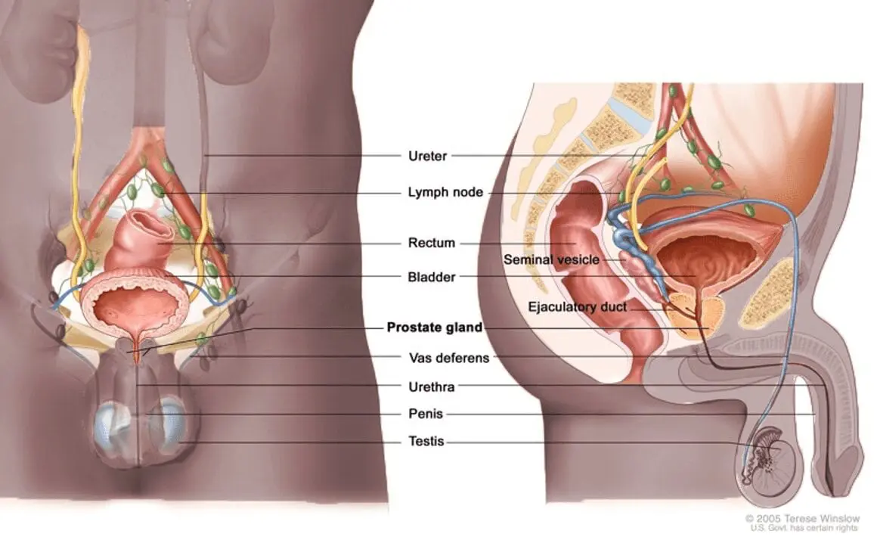
What is the Prostate?
The male reproductive system is composed of the the penis, prostate, and testicles. The prostate is found below the bladder and in front of the rectum. It produces liquid that makes up a part of semen.

Slide 8
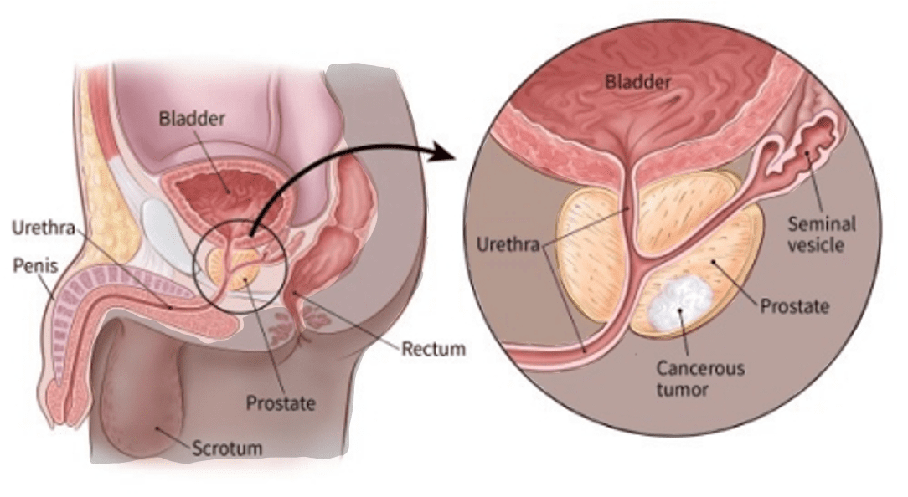
What is Prostate Cancer?
Prostate cancer is the leading cause of cancer in African American men and second to skin cancer in Caucasian men. The most common form of cancer in the prostate is adenocarcinoma, which normally is a slow growing cancer.

Slide 9
How is Prostate Cancer Detected?
Prostate cancer is normally detected with a Prostate-specific antigen (PSA) test and digital rectal examination (DRE).
Men typically begin early detection for prostate cancer between ages of 40 and 50 depending upon their risk for being diagnosed with the disease. The PSA test and DRE are used for early detection.

Slide 10
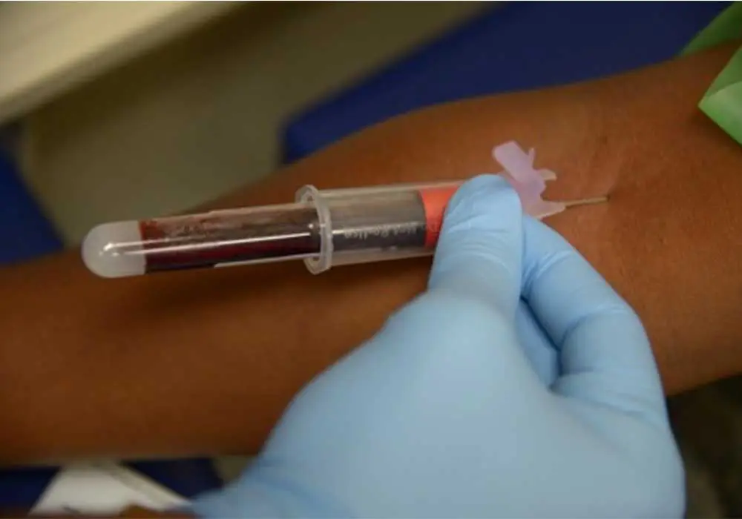
What is a PSA Test?
Prostate-specific antigen (PSA) is a protein produced by normal, as well as cancerous cells of the prostate.
The PSA test was approved by the FDA to monitor the prostate cancer growth but is also used for early detection.
A PSA test requires that your blood to be drawn and sent to a laboratory for measurements.
PSA is not just elevated in men with prostate cancer, it is also found in men with benign (not cancerous) problems. An example of which is benign prostate hyperplasia (BPH) (enlargement of the prostate). There is no evidence suggesting that BPH leads to prostate cancer.

Slide 11
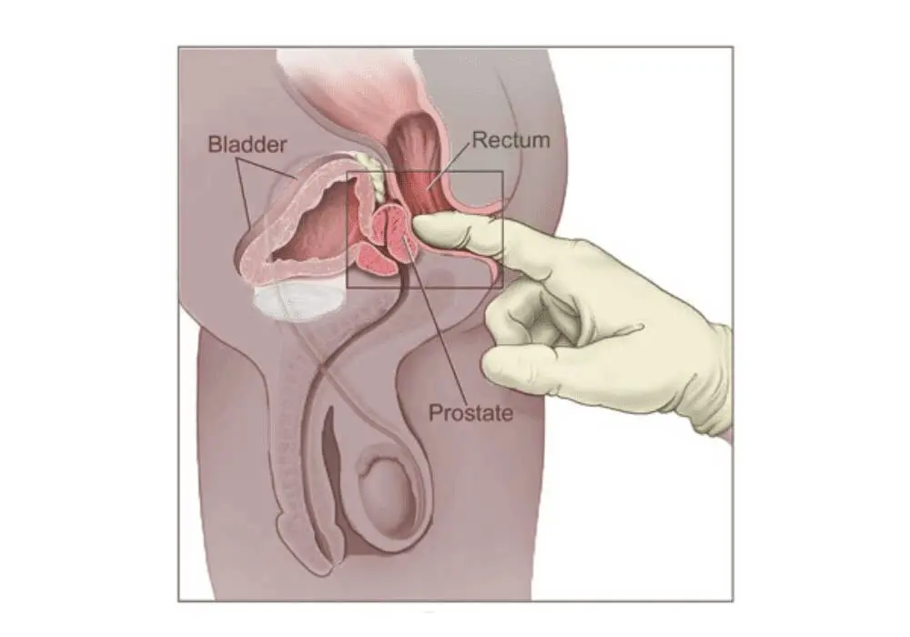
Digital Rectal Exam (DRE)
Doctors examine the prostate by inserting a lubricated-gloved finger into the rectum to feel for irregularities in the prostate. This examination is called the digital rectal examination (DRE).

Slide 12
Why Should Black Men Be Especially Interested In Early Detection Screening?
Prostate cancer is the leading cause of cancer among Black men.
All African American/Black men are at high-risk of being diagnosed with and dying from prostate cancer.
Black men are diagnosed at a rate 77% higher than white men and die at a 120% higher rate – This is the largest racial disparity for any type of major cancer for men or women.
Prostate cancer can be curable if detected early.
The Prostate cancer 10-year survival rate when detected early is more than 95% compared to 35% when detected late.

Slide 13
Long COVID-19/ Post COVID/Chronic COVID/Long Haul COVID
Most common in people who had severe COVID-19 illness; but also in people with mild illness or no symptoms from COVID-19
Unvaccinated COVID-19 individual who become infected may be at higher risk of developing post COVID conditions (some may not have tested COVID positive)
Symptoms: Respiratory, neurological, digestive, joint/muscle pain
Key: July 2021 Post COVID is considered a disability under the American with Disabilities Act (ADA)

Slide 14
Health Inequities
Health inequities may put some people from racial or ethnic minority groups and some people with disabilities at greater risk from getting COVID-19 and developing post COVID conditions

Slide 15
At What Age Should Black Men Begin Early Detection Testing?
Black men should talk with their doctors beginning at age 40 to get a baseline PSA test. A baseline digital rectal (DRE) exam should also be discussed with your doctor.
PSA testing should continue to be a consideration for men with a life expectancy of ten (10) years or more.
These recommendations are based upon information from these organizations:
The American Cancer Society (ACS) Recommendation
The National Comprehensive Cancer Network (NCCN) Guideline
The U. S. Preventive Services Task Force Recommendation
The American Urological Association (AUA)
Talk with your doctor about a baseline PSA test and DRE beginning at age 40!

Slide 16
What Happens After The Baseline PSA Test?
Based upon the baseline PSA number your doctor may perform a digital rectal exam, schedule your next PSA test, or refer you to a urologist for further tests if your PSA is considered to be high
You should track each PSA test number and compare it to the others to see if your PSA is rising, and if so, how fast. Review with your doctor following each PSA test.
Get a PSA test each year unless your doctor thinks more frequent, or less frequent, testing is in order.
Know your PSA number!

Slide 17
What Is A Normal PSA Number?
The median PSA number for men aged 40 to 49 ranges from 0.5 ng/ml to 0.9 ng/ml.
Men with a PSA higher than the median are at a greater risk for prostate cancer and aggressive prostate cancer.
The PSA number typically increases with age and the rate of increase is important to track.
A high PSA number does not necessarily indicate prostate cancer: exercise, sex, an enlarged or irritated prostate can cause the PSA number to increase.
Track your PSA number and discuss with your doctor!

Slide 18
What Are The Potential Benefits Of Early Detection Screening?
A normal PSA test may put your mind at ease about your prostate cancer risk.
A PSA test may find prostate cancer early before it has spread. However, not all prostate cancer is life threatening and tests are available to help determine if prostate cancer requires immediate treatment.
Early detection allows for treatment of prostate cancer at an early stage that may help avoid complications from the disease.
Early detection allows for treatment of prostate cancer that may reduce your risk of death from the disease
Early detection may help you live longer!

Slide 19
What are the potential risks of early detection screening?
A normal PSA test may be inaccurate (false negative)
An abnormal PSA test may suggest that something is wrong when it isn’t (false positive) and lead to other tests that may be unnecessary.
A high PSA test may find a prostate cancer that is slow growing and would never have caused problems.
Talk with your doctor about the potential risks!

Slide 20
What are signs of Prostate cancer?
A weak or interrupted (stop-and-go) flow of urine
Sudden urge to urinate or frequent urination, especially at night.
Trouble starting the flow of urine and trouble emptying the bladder completely.
Pain or burning while urinating.
Pain in the back, hips, or pelvis that doesn’t go away.
Shortness of breath, feeling very tired, fast heartbeat, dizziness, or pale skin caused by anemia.
Always talk to your doctor about any sign!a

Slide 21
Early Detection Saves Lives!

Slide 22
Facing Prostate Cancer?
INITIAL PROSTATE CANCER DIAGNOSIS
For patients initially diagnosed with prostate cancer before treatment.
PSA RECURRENCE AFTER SURGERY
For patients with a PSA biochemical recurrence after prostate removal.
CANCER PROGRESSION AFTER RADIATION
For patients with a PSA biochemical progression after being treated with radiation.
ADVANCED HORMONE SENSITIVE CANCER
For patients with advanced prostate cancer that still responds to hormone (androgen deprivation) treatment.
CASTRATION-RESISTANT CANCER
For patients with advanced prostate cancer that no longer responds to hormone (androgen deprivation) treatment.

